Slide 1


ADHIYAMAAN COLLEGE OF ENGINEERING (AUTONOMOUS) HOSUR – 635 109
DEPARTMENT OF COMPUTER SCIENCE AND ENGINEERING
MINI PROJECT
HOUSE PRICE PREDICTION USING LINEAR REGRESSION
TEAM MEMBERS: GUIDED BY:
DHANUSH.K.A (6176AC21UCS024) Mrs.T.VINODHINI , M.E.,
DAMODHARAN.M (6176AC21UCS017) ASSISTANT PROFESSOR
GANESH BABU.C (6176AC21UCS030) DEPARTMENT OF CSE
GAGAN.R (6176AC21UCS173)

Slide 2
ABSTRACT:
People looking to buy a new home tend to be more conservative with their budgets and market strategies.
This project aims to analyze various parameters like average income, average area etc. and predict the house price accordingly.
For the price prediction we will be using Linear Regression.
The functioning of this project involves some good amount of dataset on which prediction can be done.
This application will help customers to invest in an estate without approaching an agent.

Slide 3
OBJECTIVE:
It is very difficult to search house at places like Bangalore.
Even if you find a house it is very difficult to get a perfect price for your expectation.
To overcome such problem Machine Learning technique can be used.
Using Machine Learning Technique it will be easy to know the price of house based on the area available, number of bedrooms, facilities available.

Slide 4
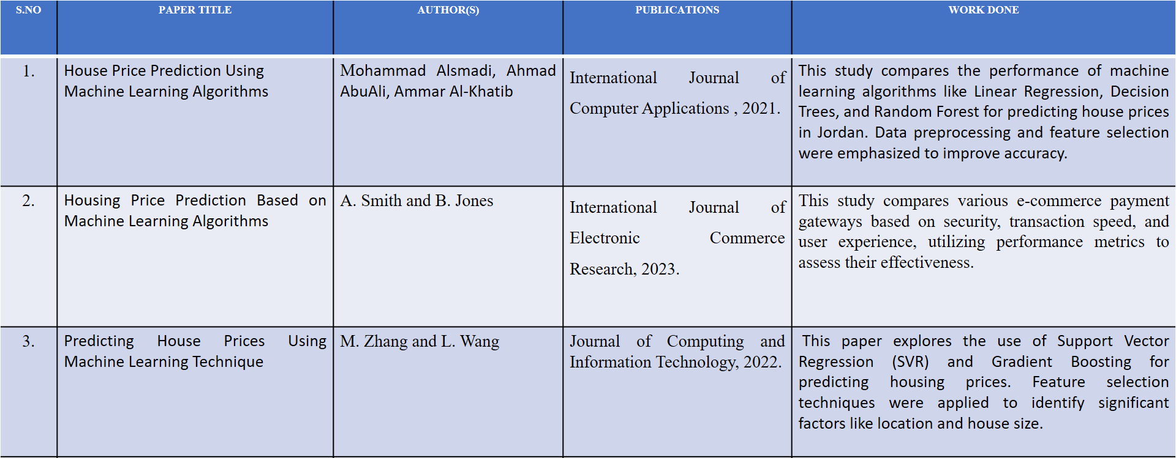
LITERATURE SURVEY:

Slide 5
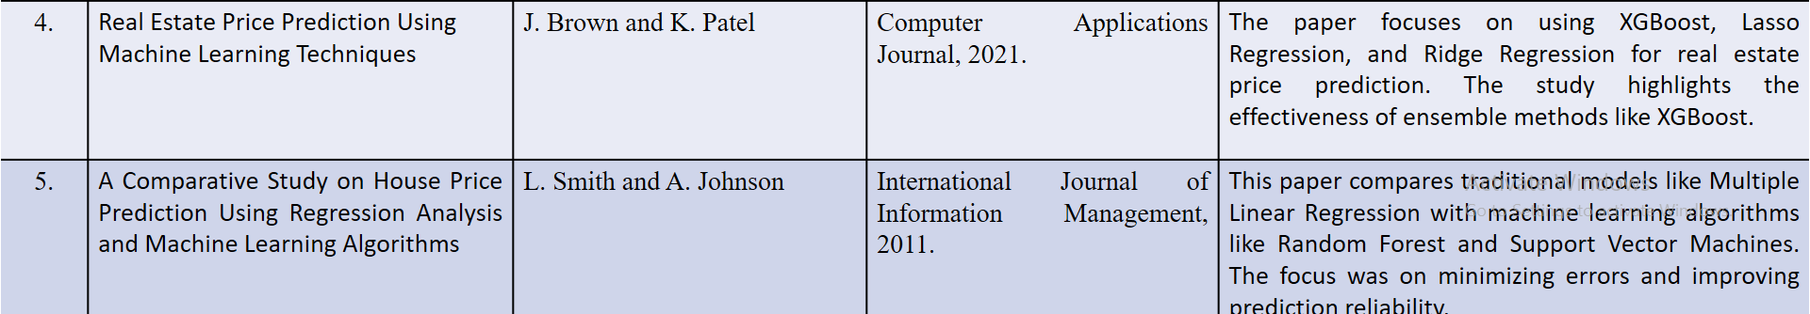

Slide 6
DISADVANTAGES:
Inaccurate Results: The price prediction will be wrong or unreliable.
Irrelevant Estimates: The predictions won’t match real-world values.
Poor User Experience: Buyers and sellers won’t trust or use the tool.
Missed Market Trends: The model can’t reflect changes in property value.
No Competitive Advantage: The tool will be less useful than other similar tools.

Slide 7
PROPOSED SYSTEM :
Location: Determines the desirability and market demand based on the property’s area.
Size: Considers the total built-up area in square feet or meters.
Land Price: Includes the cost of the land per unit area in the specific location.
Furnished/Unfurnished: Evaluates whether the house is fully furnished, semi-furnished, or unfurnished.
BHK (Bedrooms, Hall, Kitchen): Captures the configuration and layout of the house.
Prediction of Price: Uses these factors in a linear regression model to estimate the house’s market price.

Slide 8
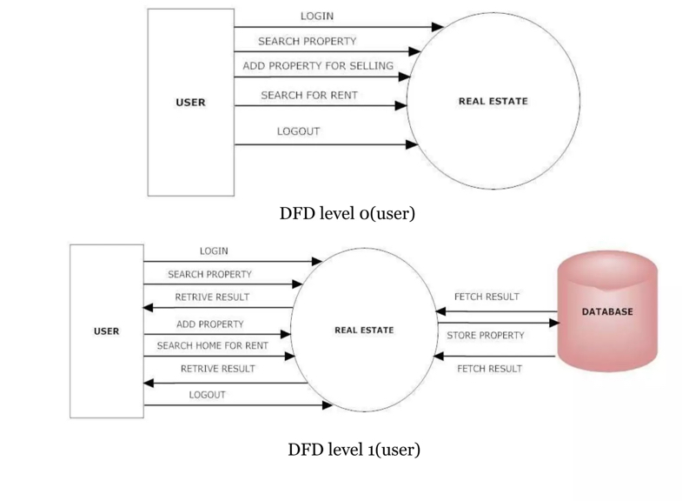
ARCHITECTURAL DESIGN:

Slide 9
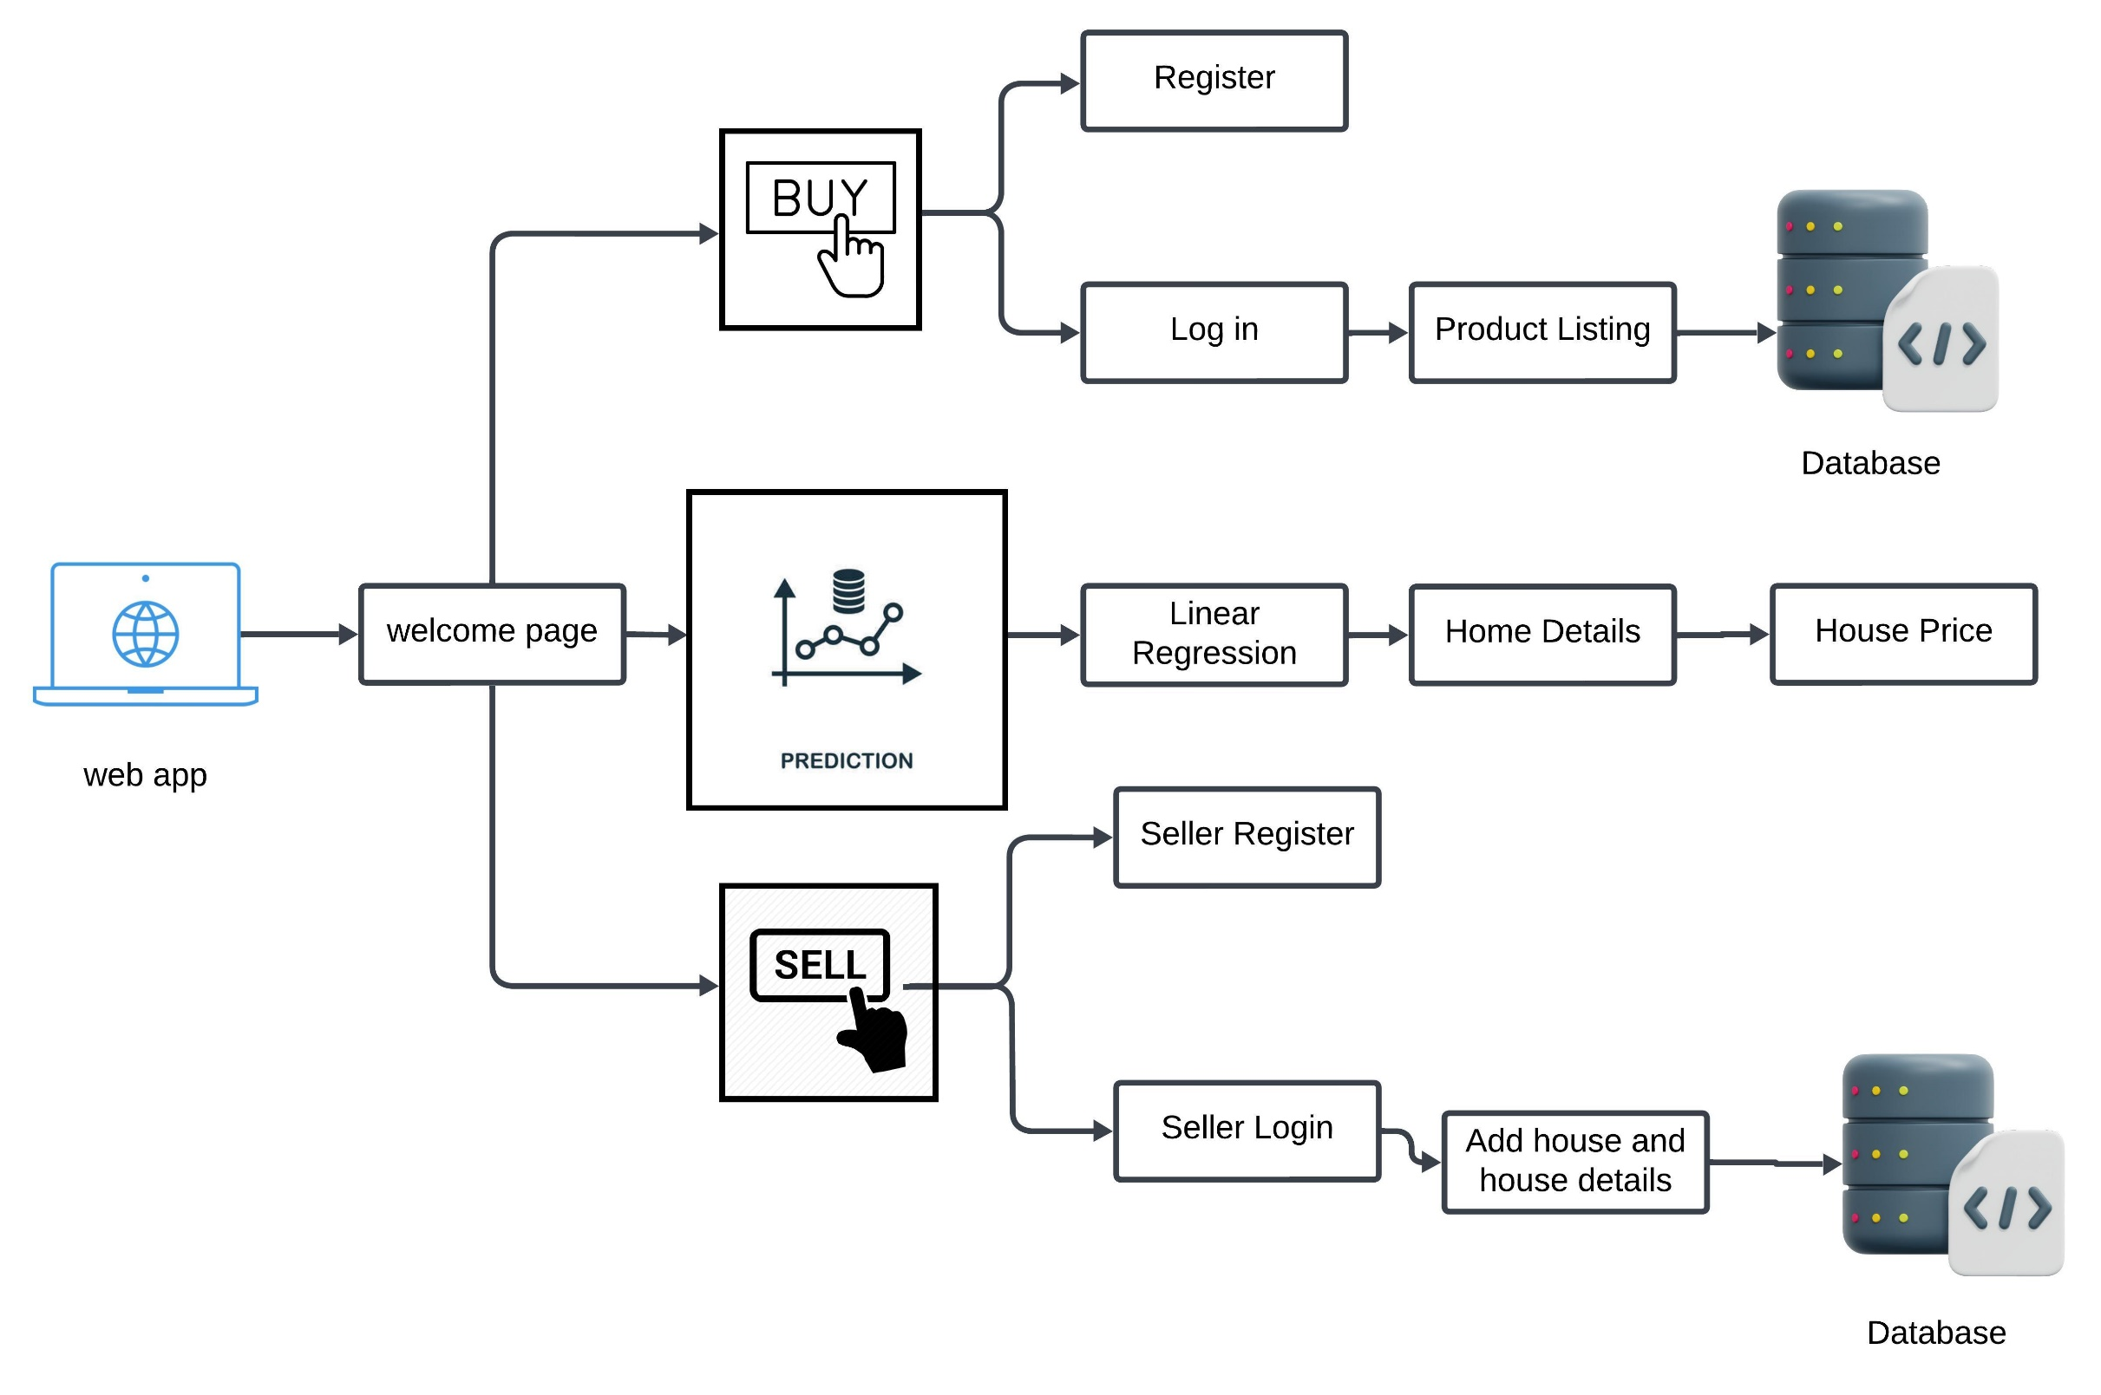
ARCHITECTURAL DESIGN:

Slide 10
MODULES:
Data Collection: Collecting historical house pricing data from reliable sources (e.g., Kaggle, public datasets).
Data Preprocessing: Cleaning, handling missing values, and feature scaling.
Feature Selection: Identifying key features such as location, square footage, number of bedrooms, etc.
Model Selection: 1Bhk, 2Bhk, 3bhk, Duplex, with balcony or without.
Evaluation: Using training and test datasets for performance evaluation.

Slide 11
TECHNIQUES:
1. Linear Regression
• Description: A simple yet powerful algorithm that models the relationship between house prices and features (e.g., square footage, location) as a linear equation.
• Use Case: Ideal for datasets with a linear relationship between features and prices.
2. Decision Trees
• Description: A tree-like model where each node represents a feature and branches represent decisions, leading to a price prediction at the leaves.
• Use Case: Works well with non-linear data and helps identify important features.

Slide 12
TECHNIQUES:
3.Random Forest
• Description: An ensemble learning technique that combines multiple decision trees to improve prediction accuracy.
• Use Case: Reduces overfitting, works well with large datasets and complex relationships.

Slide 13
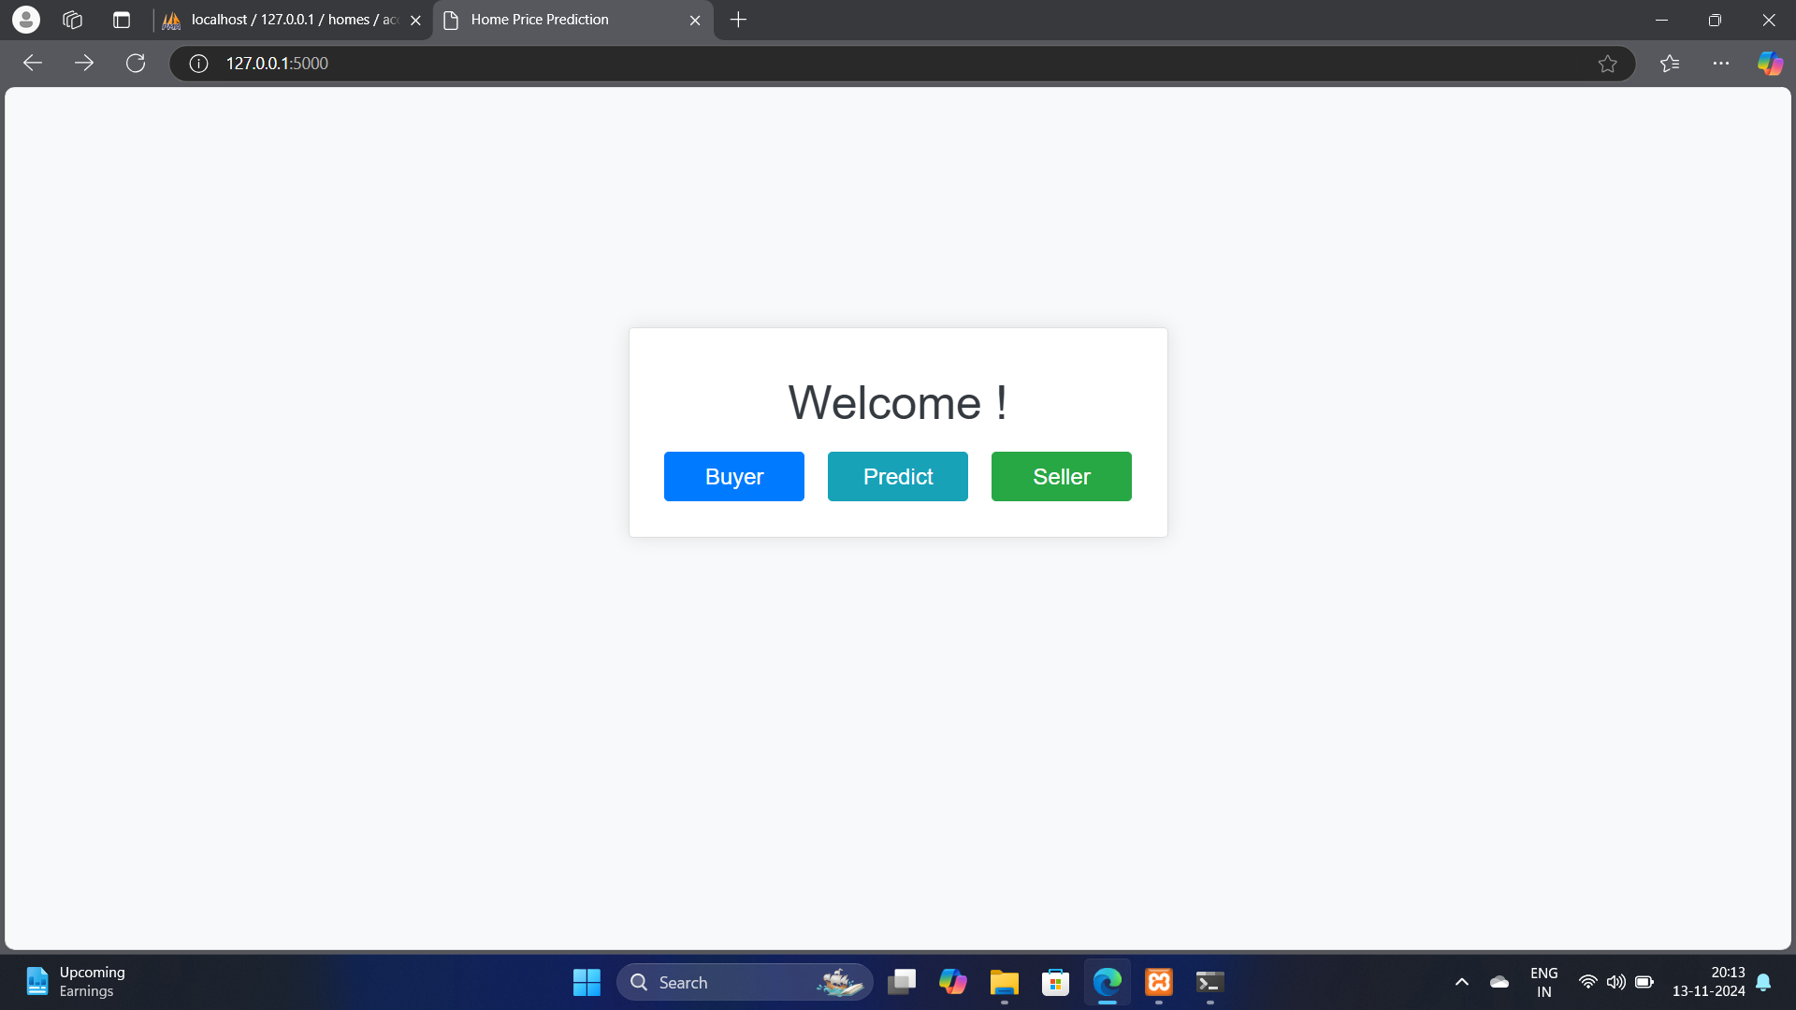
RESULT OBTAINED:

Slide 14
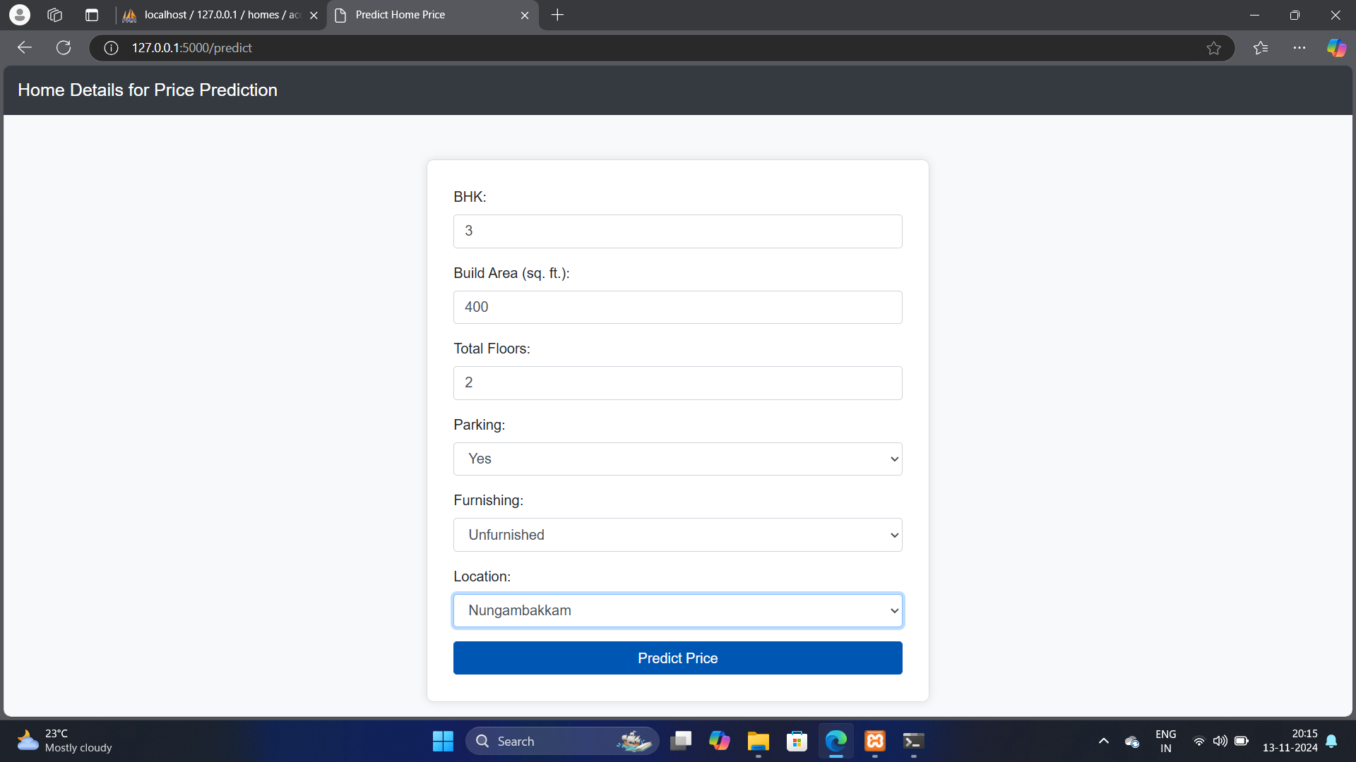

Slide 15
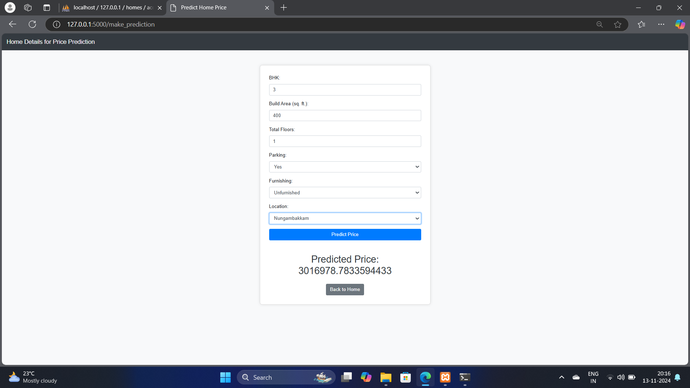

Slide 16
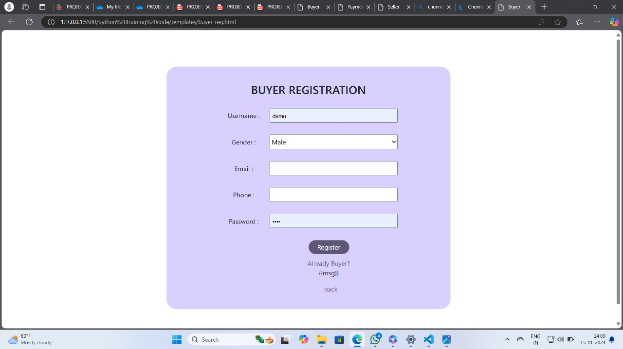

Slide 17
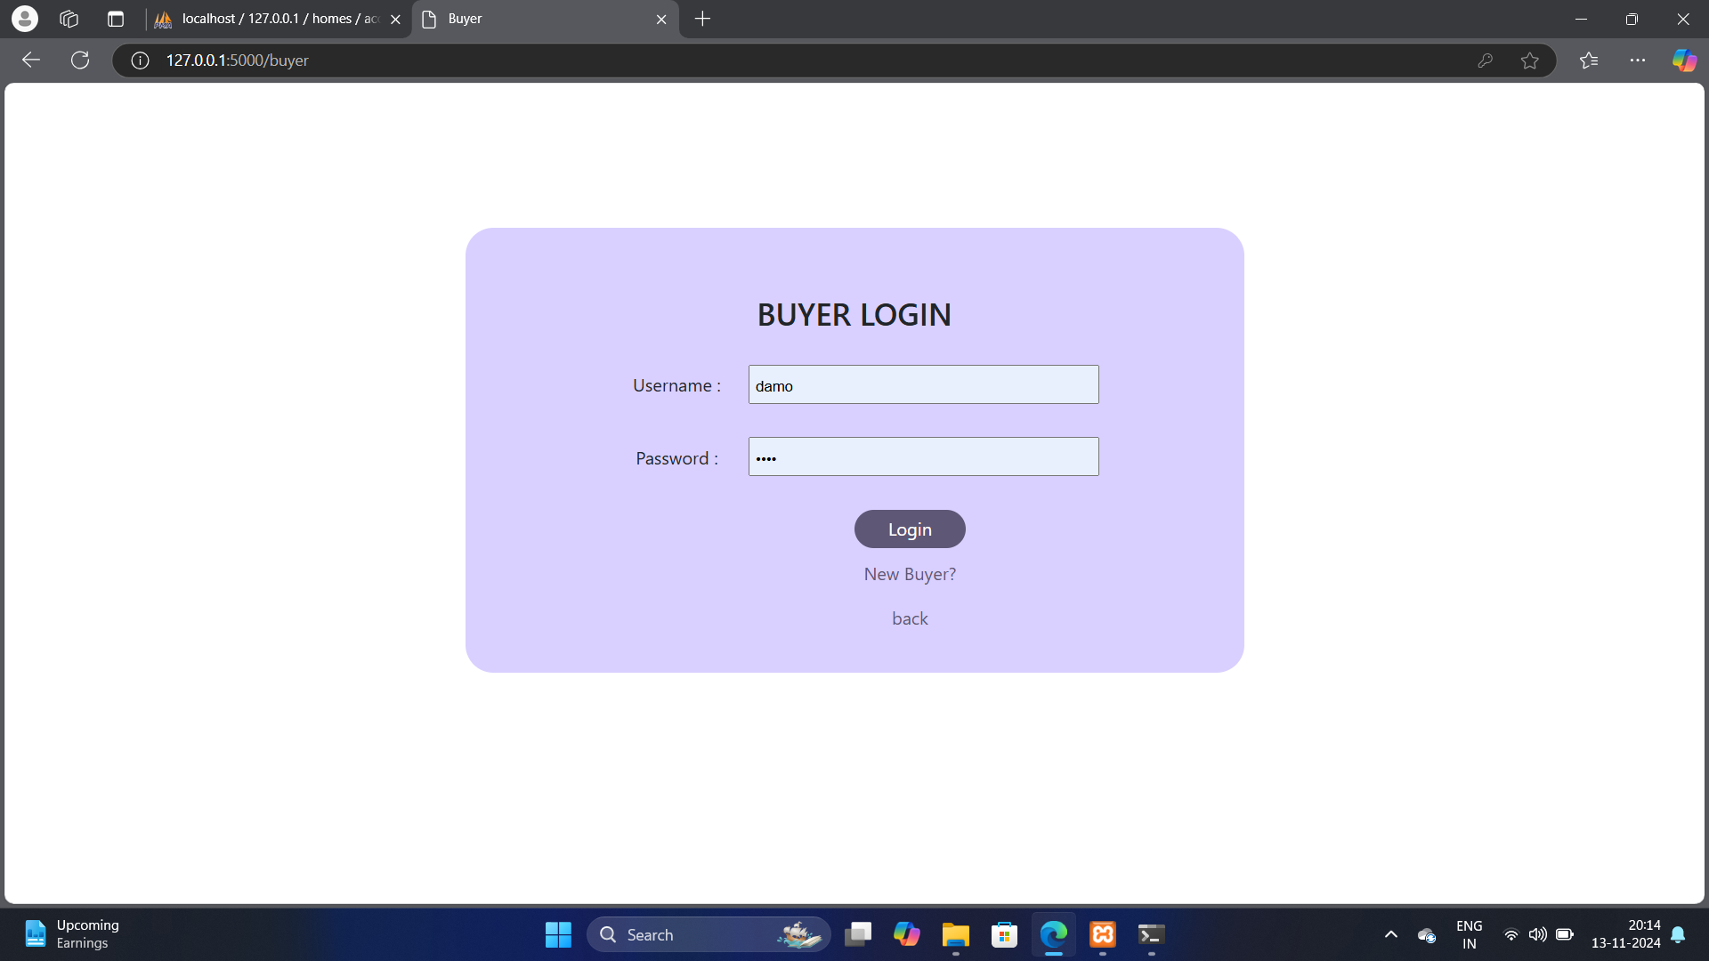

Slide 18


Slide 19
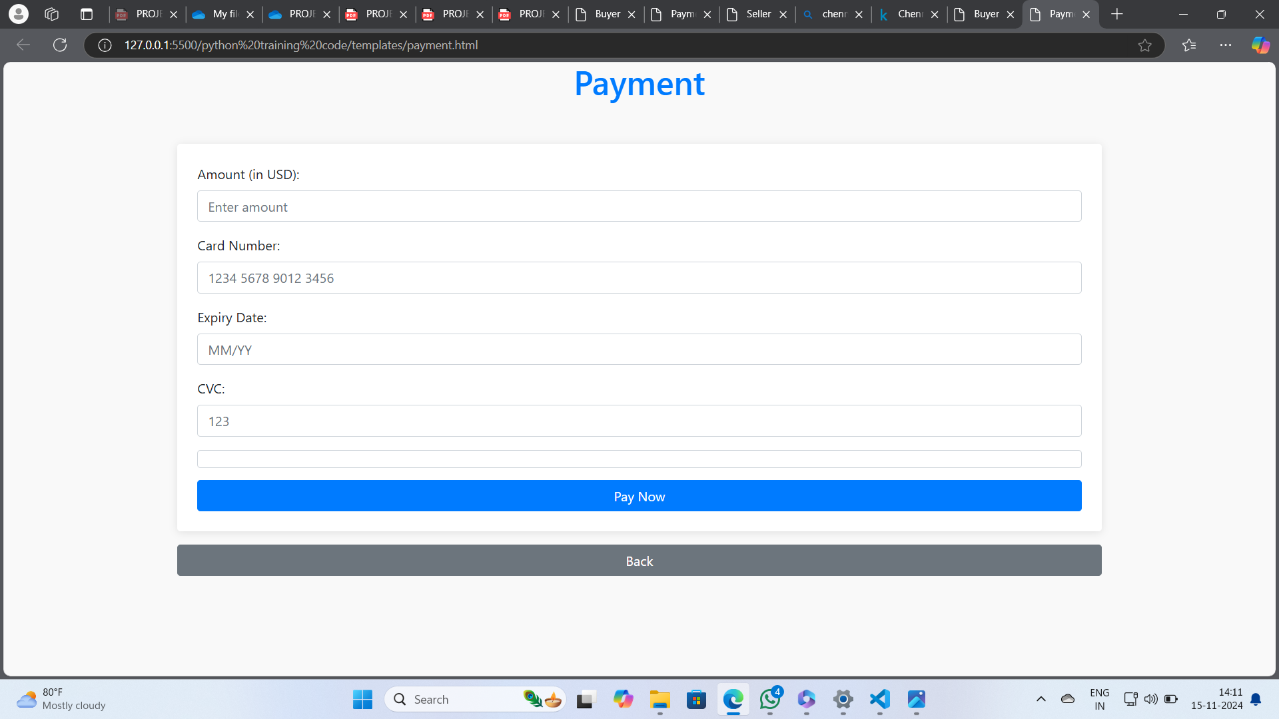

Slide 20
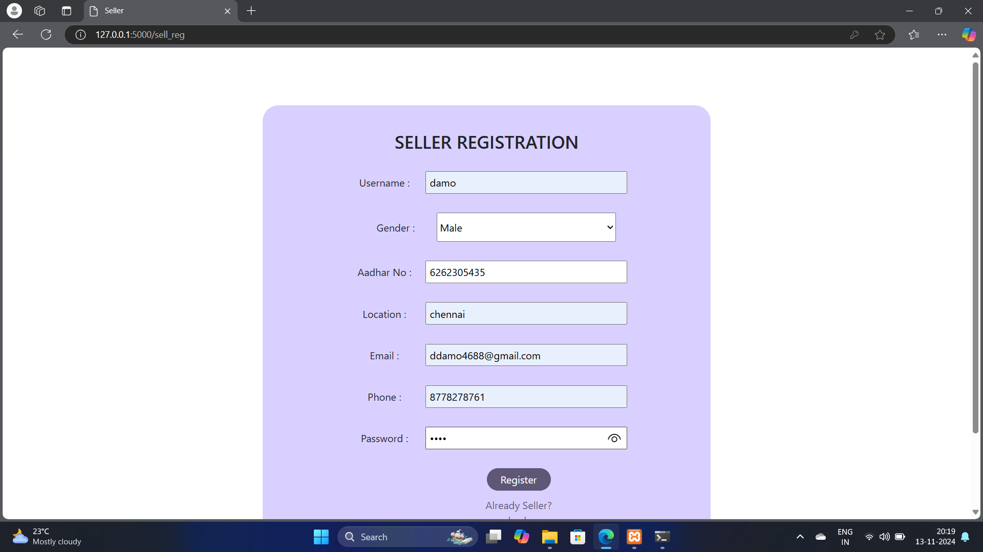

Slide 21
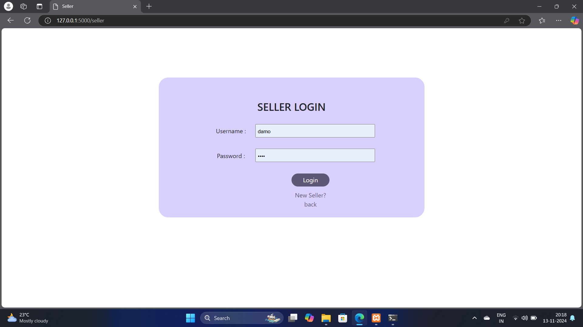

Slide 22
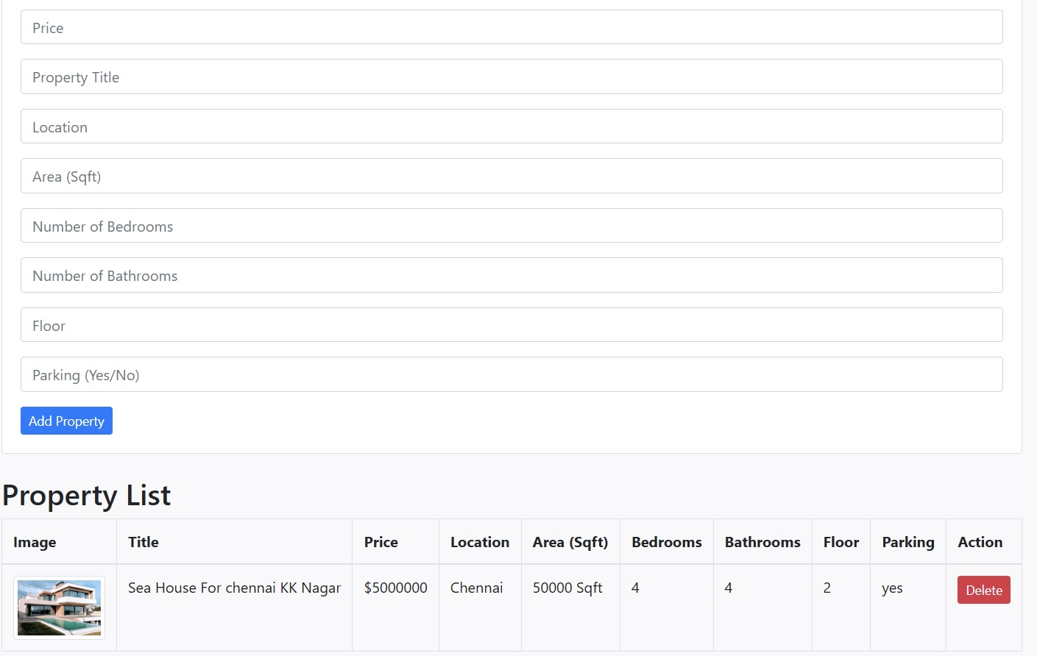

Slide 23
REFERENCE:
[1] House Price Index. Federal Housing Finance Agency. https://www.fhfa.gov/ (accessed September 1, 2023).
[2] Phan TD. Housing Price Prediction Using Machine Learning Algorithms: The Case of Melbourne City, Australia. 2018 International Conference on Machine Learning and Data Engineering (ICMLDE) 2023.
[3] Lu S, Li Z, Qin Z, Yang X, Goh RSM. A hybrid regression technique for house prices prediction. 2024 IEEE International Conference on Industrial Engineering and Engineering Management (IEEM) 2020.
[4] Markzukerg Housing price in California. Kaggle 2018. https://www.kaggle.com/ruiqurm/lianjia/ (accessed June 1, 2023).
[5] Mu J, Wu F, Zhang A. Housing Value Forecasting Based on Machine Learning Methods. Abstract and Applied Analysis 2024;2024:1–7.

Slide 24
THANK YOU !!

